Slide 1
GUI and Event Programming Session 13
Course : COMP6056
Effective Period : September 2021

Slide 2
Sub Topics
GUI
Design GUI
Event Handlers
Design apps for Mobile Devices

Slide 3
These slides have been adapted from: Gaddis, T. (2019). Starting Out with Programming Logic and Design 5^{th.} ISBN: 978-0-13-480115-5 Chapter 15
Acknowledgement

Slide 4
Learning Objectives
At the end of this lecture, students are able to:
LO1: To explain GUI and Event Oriented Programming
LO2: To write pseudo-code to solve problem using GUI and Event Programming

Slide 5
Graphical User Interface
A graphical user interface allows the user to interact with the operating system and other programs using graphical elements such as icons, buttons, and dialog boxes.
A computer’s user interface is the part of the computer that the user interacts with.
One part of the user interface consists of hardware devices, such as the keyboard and the video display.
Another part of the user interface lies in the way that the computer’s operating system accepts commands from the user. For many years, the only way that the user could interact with an operating system was through a command line interface
Gaddis, T., Starting Out With Programming Logic and Design, 5 ed, ISBN: 978-0-13-480115-5

Slide 6
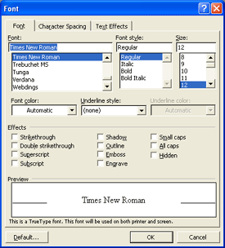
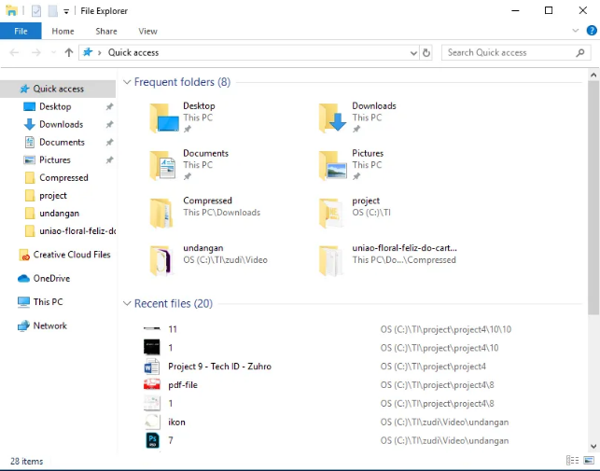
Graphical User Interface
In the 1980s, a new type of interface known as a graphical user interface came into use in commercial operating systems.
A graphical user interface (GUI) (pronounced “gooey”) allows the user to interact with the operating system through graphical elements on the screen.
GUIs also popularized the use of the mouse as an input device. Instead of requiring the user to type commands on the keyboard, GUIs allow the user to point at graphical elements and click the mouse button to activate them
Example: Windows
Gaddis, T., Starting Out With Programming Logic and Design, 5 ed, ISBN: 978-0-13-480115-5

Slide 7
GUI Programs Are Event-Driven
In a text-based environment, such as a command line interface, programs determine the order in which things happen
In a GUI environment, however, the user determines the order in which things happen
GUI programs must respond to the actions of the user, it is said that they are event-driven.
The user causes events to take place, such as the clicking of a button, and the program must respond to the events.
Gaddis, T., Starting Out With Programming Logic and Design, 5 ed, ISBN: 978-0-13-480115-5

Slide 8
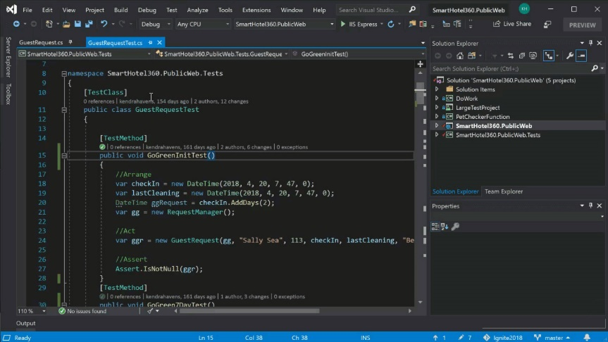
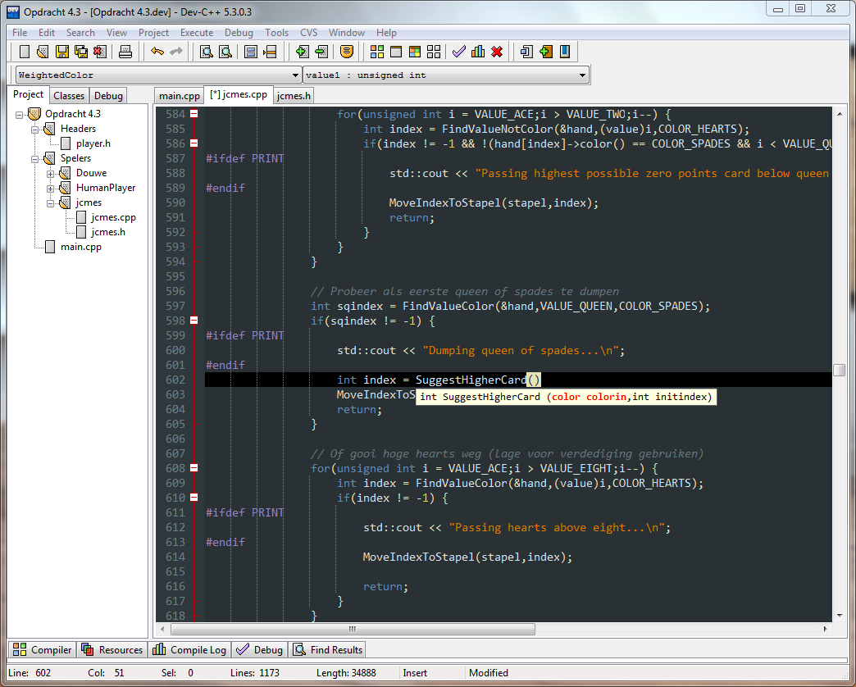
Designing the User Interface for a GUI Program
There are several Integrated Development Environments (IDEs) that allow you to construct a program’s windows and its graphical elements visually without writing a single line of code.
For example, Microsoft Visual Studio allows you to create GUI programs using the Visual Basic, C++, and C# programming languages. There are several other IDEs as well.
Gaddis, T., Starting Out With Programming Logic and Design, 5 ed, ISBN: 978-0-13-480115-5

Slide 9
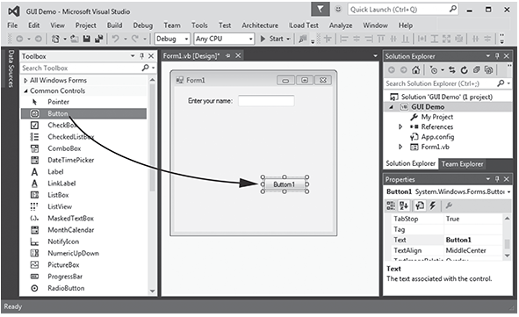
Designing the User Interface for a GUI Program
Gaddis, T., Starting Out With Programming Logic and Design, 5 ed, ISBN: 978-0-13-480115-5

Slide 10
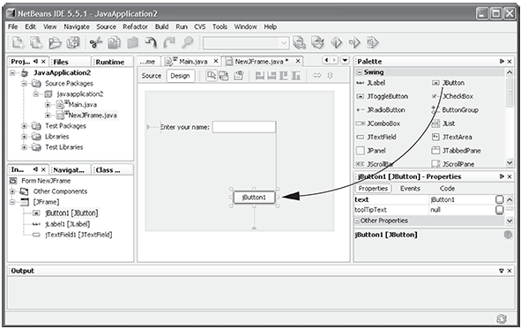
Designing the User Interface for a GUI Program
Gaddis, T., Starting Out With Programming Logic and Design, 5 ed, ISBN: 978-0-13-480115-5

Slide 11
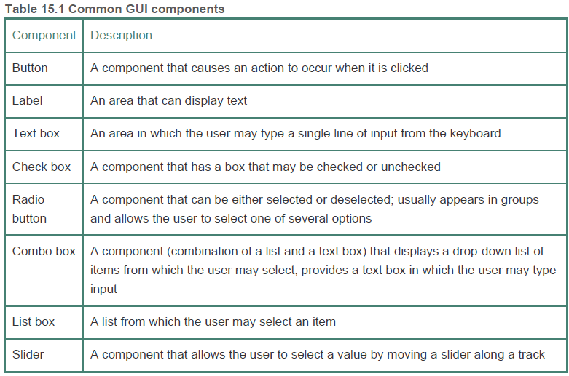
GUI Component
Gaddis, T., Starting Out With Programming Logic and Design, 5 ed, ISBN: 978-0-13-480115-5

Slide 12
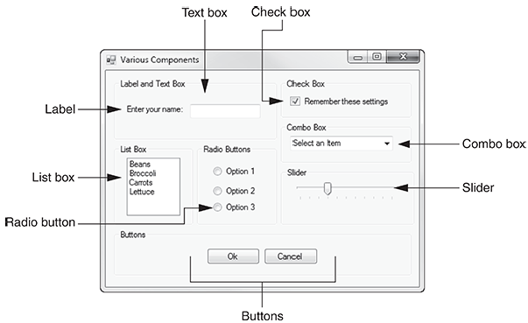
Designing the User Interface for a GUI Program
Gaddis, T., Starting Out With Programming Logic and Design, 5 ed, ISBN: 978-0-13-480115-5

Slide 13
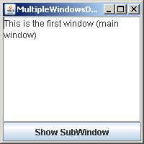
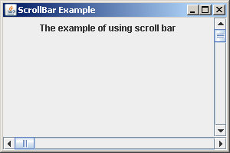
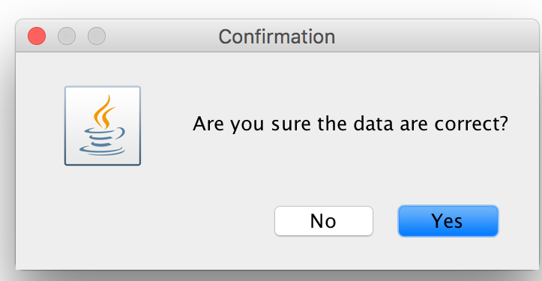
Scroll Bar
Text Area
Dialog Box

Slide 14
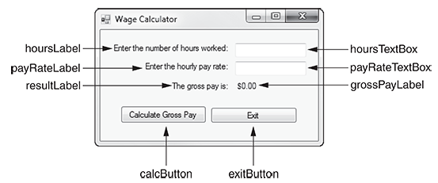
GUI Component
Component Names
Gaddis, T., Starting Out With Programming Logic and Design, 5 ed, ISBN: 978-0-13-480115-5

Slide 15
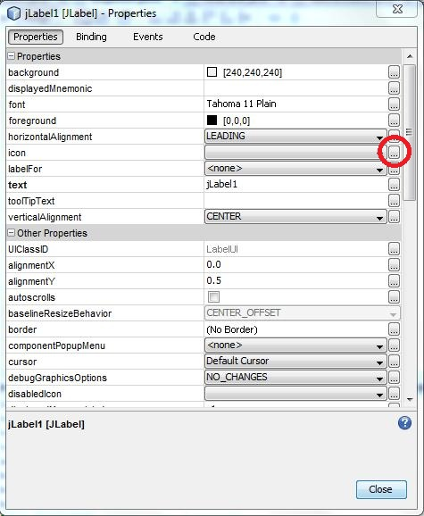
GUI Component
Properties
Most GUI components have a set of properties that determines how the component appears on the screen.
Typically, components have properties that specify the component’s color, size, and position.
Like variables, properties can be set to values. When you set a property to a value, it changes some aspect of the component that it belongs to.
Gaddis, T., Starting Out With Programming Logic and Design, 5 ed, ISBN: 978-0-13-480115-5

Slide 16
Writing Event Handlers
If you want a GUI program to perform an action when an event occurs, you must write code, known as an event handler, which responds to that event.
After you create a GUI program’s user interface, you can write the code that responds to events.
An event is an action that takes place within a program, such as the clicking of a button.
Part of writing a GUI application is creating event handlers. An event handler is a module that automatically executes when a specific event occurs. If you want a program to perform an operation when a particular event occurs, you must create an event handler that responds when that event takes place. In pseudocode, our event handlers will be written in the following general format
Gaddis, T., Starting Out With Programming Logic and Design, 5 ed, ISBN: 978-0-13-480115-5

Slide 17
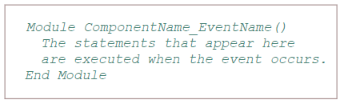
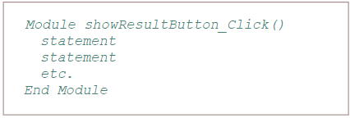
Writing Event Handlers
In pseudocode, our event handlers will be written in the following general format
Example
Gaddis, T., Starting Out With Programming Logic and Design, 5 ed, ISBN: 978-0-13-480115-5

Slide 18
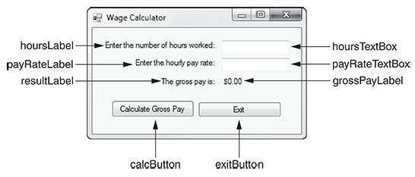
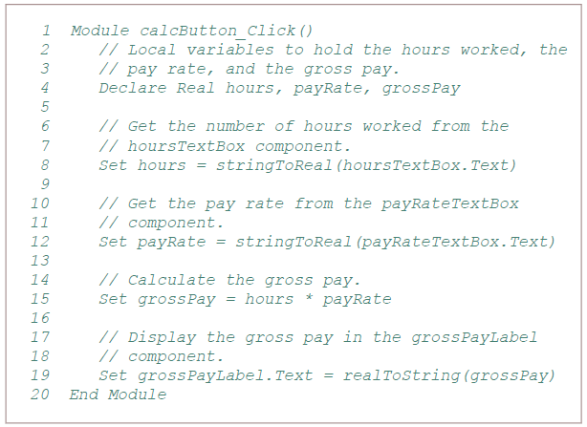
Writing Event Handlers
Gaddis, T., Starting Out With Programming Logic and Design, 5 ed, ISBN: 978-0-13-480115-5

Slide 19
Designing Apps for Mobile Devices
Smaller screen size and special hardware capabilities typically require special consideration from developers creating mobile applications.
GUIs are used in applications, or apps, that are developed for mobile devices such as smartphones and tablets. However, the physical screens on mobile devices are much smaller than those used with desktop and laptop computers.
As a result, the GUI for a mobile app is usually designed differently than the GUI for an application that is intended for a desktop or laptop computer.
Also, mobile users typically interact with apps via a touchscreen, not a mouse and a physical keyboard.
Gaddis, T., Starting Out With Programming Logic and Design, 5 ed, ISBN: 978-0-13-480115-5

Slide 20

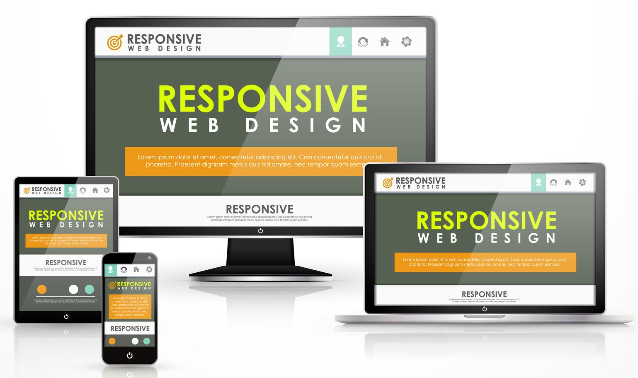

Slide 21
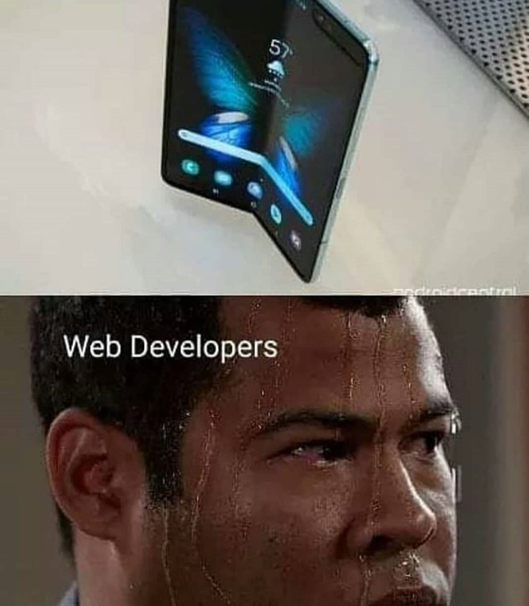
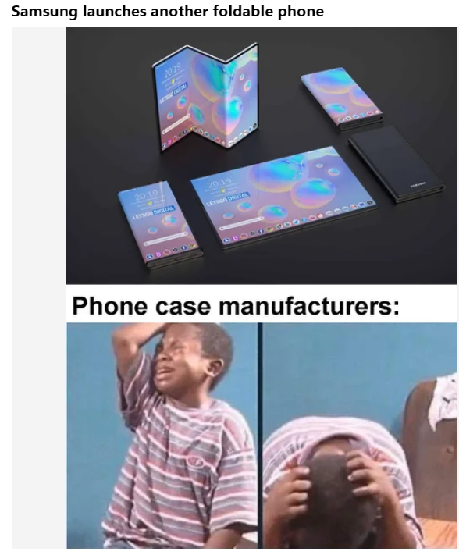

Slide 22
Guidelines
Present less information at once
Use larger font sizes for easier reading
Arrange components in a way that works for the smaller screen size
Use components that work well with touchscreens
Gaddis, T., Starting Out With Programming Logic and Design, 5 ed, ISBN: 978-0-13-480115-5

Slide 23
References
Gaddis, T. (2019). Starting Out with Programming Logic and Design 5th. ISBN: 978-0-13-480115-5

